Slide 1


EV3 Classroom: Proportional Line Follower
By Sanjay and Arvind Seshan

Slide 2
Lesson Objectives
Learn to create a proportional line follower
Prerequisites: Basic Line Follower, Color Line Follower, Color Sensor Calibration, Proportional Control, Operator Blocks (Math Blocks)

Slide 3
How Far Is the Robot From The Line?
Reflected light sensor readings show how “dark” the measured area is on average
Calibrated readings should range from 100 (on just white) to 0 (on just black)
Light Sensor Measured Area:
Reading = 100
Reading = 50
Reading = 25
Reading = 75
Reading = 0
Line

Slide 4
Line Following
Computing an error → how far is the robot from a target
Robots follow the edge of line → target should be a sensor reading of 50
Error should indicate how far the sensor’s value is from a reading of 50
Making a correction → make the robot take an action that is proportional to the error. You must multiply the error by a scaling factor to determine the correction.
To follow a line a robot must turn towards the edge of the line
The robot must turn more sharply if it is far from a line
How do you do this: You must adjust steering input on move block

Slide 5
How do you make a Proportional Line Follower?
Pseudocode:
Reset the Rotation sensor (Only required for line following for a total distance)
Compute the error = Distance from line = (Light sensor reading - Target Reading)
Scale the error to determine a correction amount. Adjust your scaling factor to make you robot follow the line more smoothly.
Use the Correction value (computed in Step 3) to adjust the robot’s turn towards the line.

Slide 6

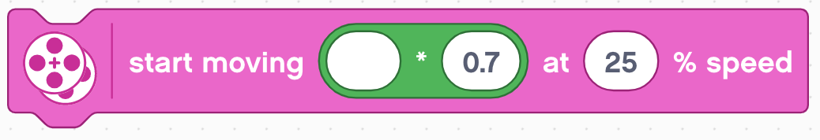
Challenge
Compute Error
Distance from line = (Light sensor reading - Target Reading)
Compute/Apply Correction
Scale the error to determine a correction amount. Use this to adjust steering input on move block
error
error

Slide 7
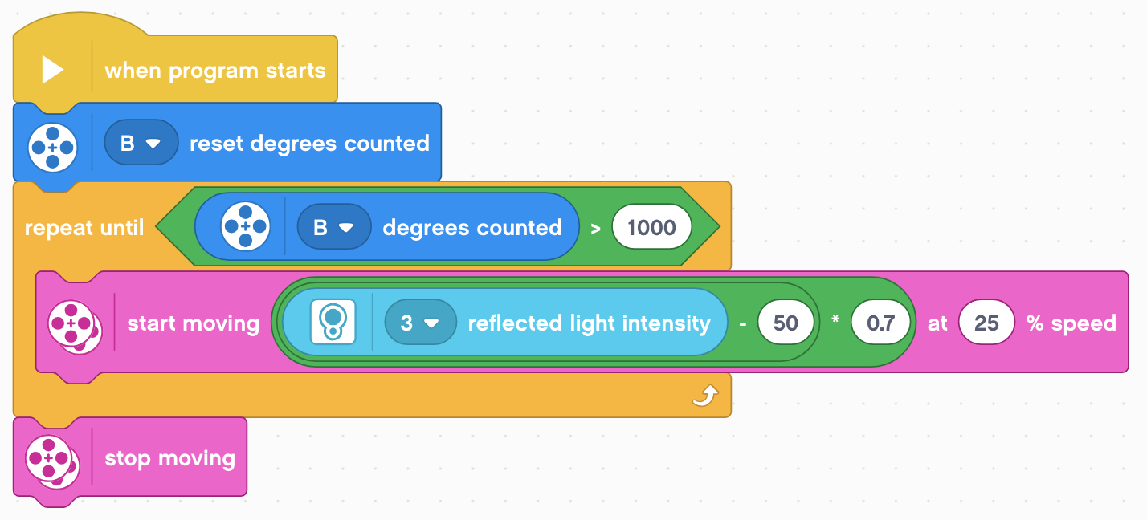
Proportional Line Follower
Note: This program uses the color sensor in reflected light mode. You will need to calibrate your color sensor. If you do not know how to calibrate, please refer to our Calibration lesson.
Part 1: Compute the Error
Our goal is to stay at the edge of the line (light sensor = 50)
Part 2: Apply the correction
The error in part 1 is multiplied by a Constant of Proportionality (0.7). This will be different for each robot/application. See slides 9-11 to learn how to tune this number.
Reset the rotation sensor
This line follower ends after 1000 degrees. Change this to suit your needs.

Slide 8
Key Step: Tuning the Constant
Note, the 0.7 constant in the previous slide is specific to our robot – you need to tune this value for yourself
This constant is called the Proportional Constant, or Constant of Proportionality
The most common way to tune your constant is trial and error.
This can take time. Here are some tips:
Start with your constant as1.0 adjust by ±0.5 initially
Adjust to a point where the controller is pretty smooth
Adjust ±0.1 for fine tuning

Slide 9
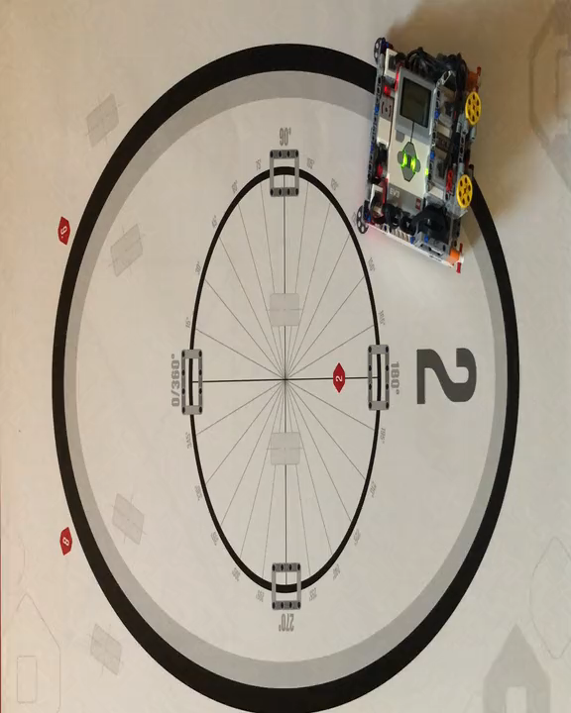
Proportional Control (0.6 Constant)
Play video. Turn on volume

Slide 10
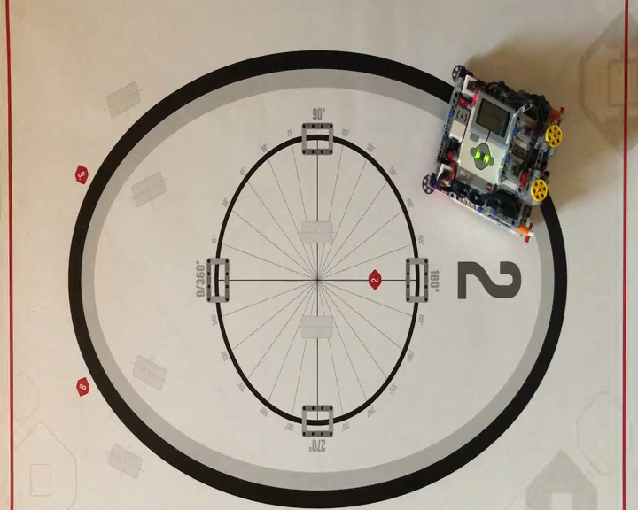
Proportional Control (0.8 Constant)
Play video. Turn on volume

Slide 11

Credits
This tutorial was created by Sanjay Seshan and Arvind Seshan
More lessons at www.ev3lessons.com
This work is licensed under a Creative Commons Attribution-NonCommercial-ShareAlike 4.0 International License.

